Slide 1


Darfur in Sudan
Holocaust Memorial Day
Holocaust Memorial Day is on
27 January every year

Slide 2
Darfur in Sudan
Identity
What characteristics, beliefs, attributes, and traits does your identity comprise? Please list different components of your identity.
• Which of these identities are visible/invisible?
• Which identities have you chosen?
• How do your different identities shape your life? What do they mean to you?

Slide 3
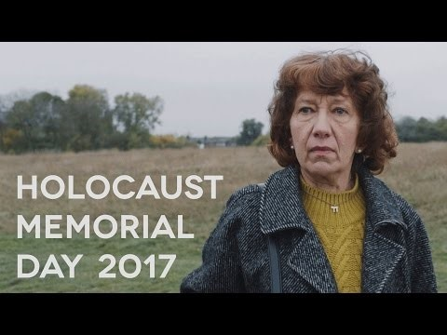
Identity and discrimination
Darfur in Sudan
What examples of hatred and prejudice are shown in this film?
What is the link between what the Nazis did to Bea’s father and the contemporary hate crimes shown in the film?
How are humans shown to support those who face hate and prejudice due to their identity?

Slide 4
Darfur in Sudan
What is discrimination?
Discrimination means treating someone less favourably or unfairly, or causing disadvantage to someone, because of some characteristics of their identity.

Slide 5

Darfur in Sudan
What is antisemitism?
Antisemitism is a certain perception of Jews, which may be expressed as hatred toward Jews.
Rhetorical and physical manifestations of antisemitism are directed toward Jewish or non-Jewish individuals and/or their property, toward Jewish community institutions and religious facilities.
- Extract from International Holocaust Remembrance Alliance definition,
adopted by the UK Government, December 2016
Antisemitism has been referred to as ‘The Longest Hatred’ having survived and mutated throughout history.
The Star of David
– a symbol of Jewish faith.

Slide 6
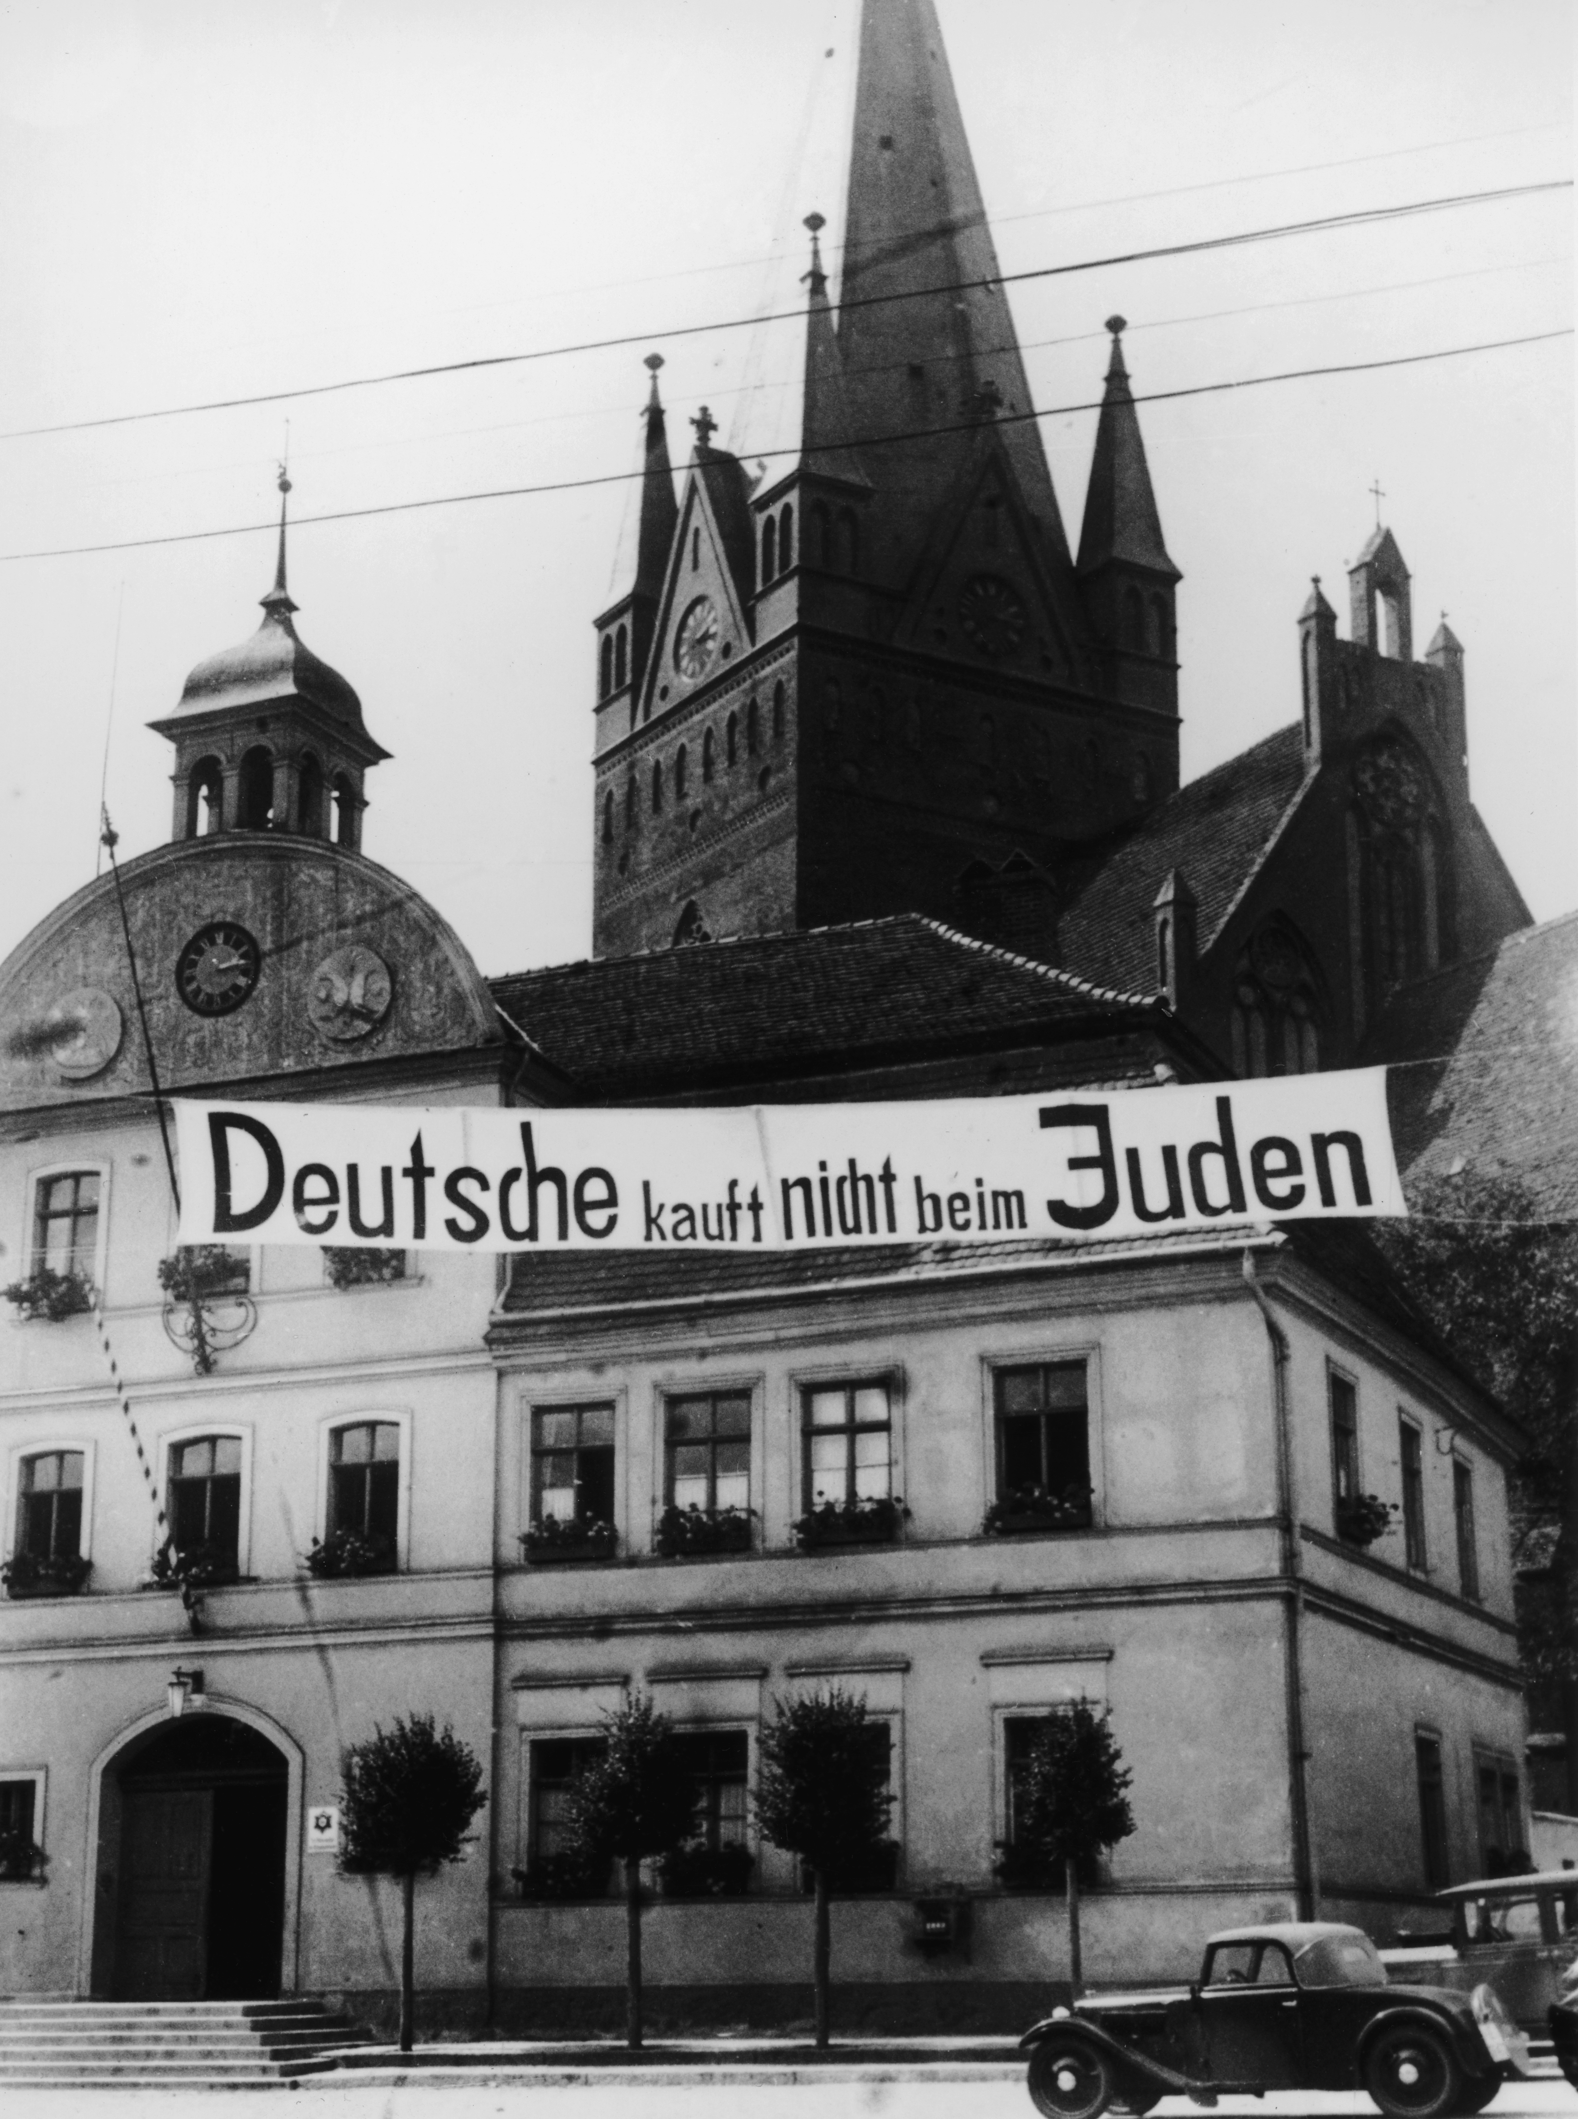
Darfur in Sudan
The Holocaust
The Nazis came to power in Germany in 1933 led by Adolf Hitler.
The Nazis used propaganda and centuries of antisemitism as their foundation to justify changing laws to deny human rights to Jews.
In 1935, the Nazis passed the Nuremberg Laws that defined who was Jewish and prohibited marriage between Jews and non-Jews.
Between 1933 and 1945, the Nazis attempted to annihilate all of Europe’s Jews.
This systematic and planned attempt to murder European Jewry is known as the Holocaust. In total the Nazis murdered six million Jews.
circa 1937: A banner reading 'Deutsche, kauft nicht beim Juden' ('Germans, do not buy from Jews') in front of the Fasanenstrasse Synagogue in Berlin, Germany. The synagogue was later burned by Nazis during the 'Kristallnacht' riots on November 9, 1938. (Photo by Anthony Potter Collection/Getty Images)

Slide 7
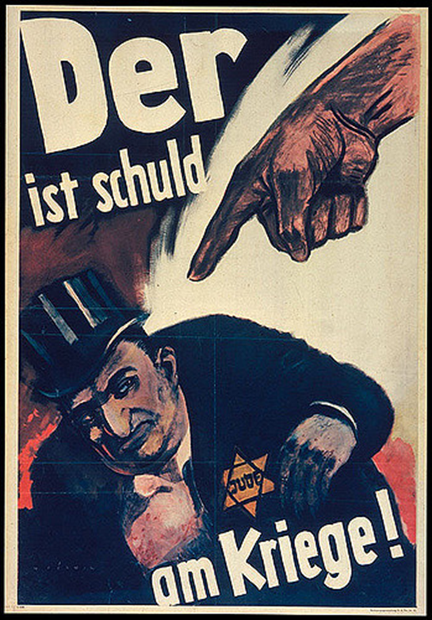
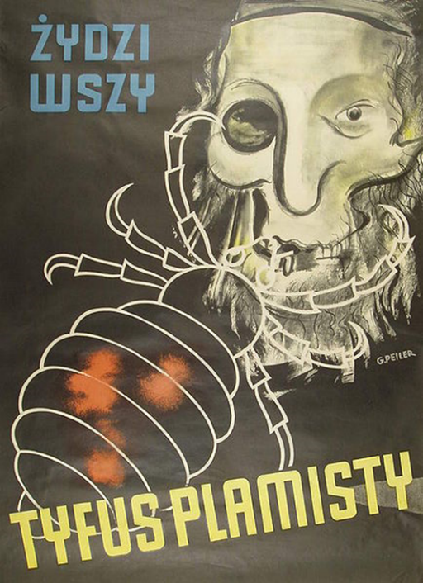
Darfur in Sudan
Nazi Propaganda
Propaganda is information, especially of a biased or misleading nature, used to promote a political cause or point of view.
By Hans Schweitzer (Mjölnir). From Library of Congress
Prints and Photographs Division Washington, D.C. 20540 USA
By German propaganda ministry, PROMI (de:Propagandaministerium) [Public domain], via Wikimedia Commons
Notes:
‘Der ist schuld am Kriege!’ – The phrase in German can be translated to ‘The war is his fault’ or ‘He is to blame for the war’.
‘Zyozi wszy’ and ‘Tyfus plamisty’ – These words in Polish imply a connection between ‘jews’, ‘lice’ and ‘typhoid fever’.

Slide 8
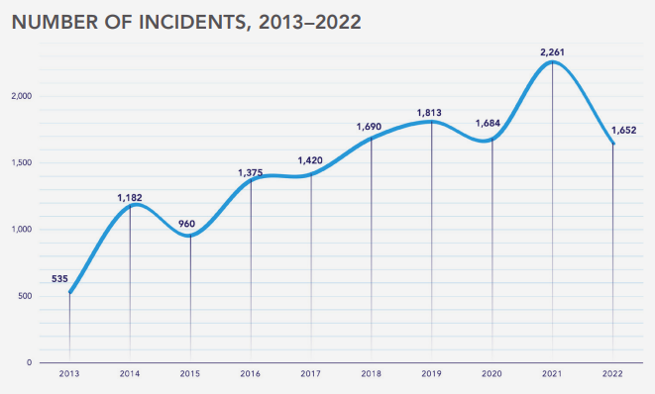
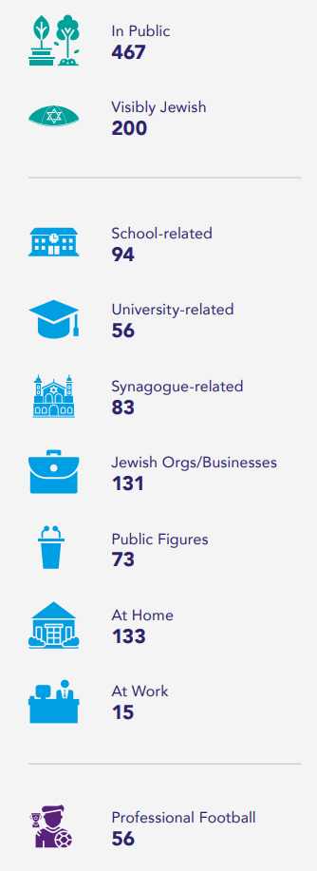
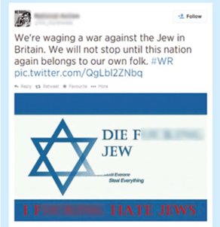
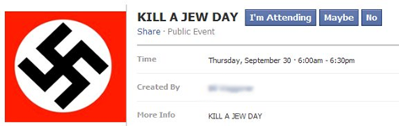
Antisemitism today
Darfur in Sudan
“I walk down a main street every Shabbos day – I don't think a week goes by that I don't get a hoot or middle fingers. It's very intimidating.” – An anonymous man
CST, Antisemitic Incidents (2022).
Community Security Trust (CST) recorded 1,652 antisemitic incidents in the UK in 2022 and 2,261 in 2021.
Online hate constituted 25% of antisemitic abusive behaviour.
Notes:
The quote on the slide comes from European Union Agency For Fundamental Rights (FRA), Experiences and perceptions
of antisemitism: Second survey on discrimination and hate crime against Jews in the EU Factsheet – United Kingdom (2018).

Slide 9
?
Questions to answer
Darfur in Sudan
Where does antisemitism take place?
Why is antisemitism common online?
What impact or consequences does it have?
How can you report online abuse on social media?

Slide 10

Darfur in Sudan
The Nazi persecution of other groups
The Nazis discriminated against different groups of people.
Of these groups, who do you think the Nazis targeted?
Mixed race
people
Indigenous people
Roma and Sinti
White people
Black people

Slide 11
Darfur in Sudan
The Nazi persecution of other groups
Mixed race
people
White people
Black people
Roma and Sinti
The Nazis’ racist policies meant that many black and mixed-race Europeans were persecuted by the Nazis.
The Nazis believed that Germans were a superior race, and that their race needed to be kept ‘pure’.
Racism continues today.
The Nazis targeted Eastern European Jews and political opponents, many of whom were white. They were not targeted because of their race.
The Nazis targeted Europe’s Roma and Sinti population for total destruction. Estimated 200,000-500,000 people were murdered.
Roma communities still face discrimination today in the UK.

Slide 12

Darfur in Sudan
Who else was discriminated against by the Nazis?
All of these groups were targeted and murdered by the Nazis.
Physically
disabled
Mentally
disabled
Homosexuals
Political
opponents
‘Asocials’
The Nazis imprisoned, sterilised and murdered gay men.
Homophobic hate crimes still occur today.
Political opponents and people deemed ‘asocial’ such as criminals and activists were imprisoned and murdered by the Nazis.
People who have served time in prison or who campaign about political issues can still face discrimination and hatred today.
Physically and mentally disabled
people were sterilised and
murdered by the Nazis.
There is a stigma about disability
in the UK today.

Slide 13

Darfur in Sudan
The Nazi persecution of other groups
Of these groups, who do you think the Nazis targeted?
Physically
disabled
Mentally disabled
Political
opponents
Homosexuals
‘Asocials’

Slide 14

Darfur in Sudan
Discrimination today in the UK

Slide 15
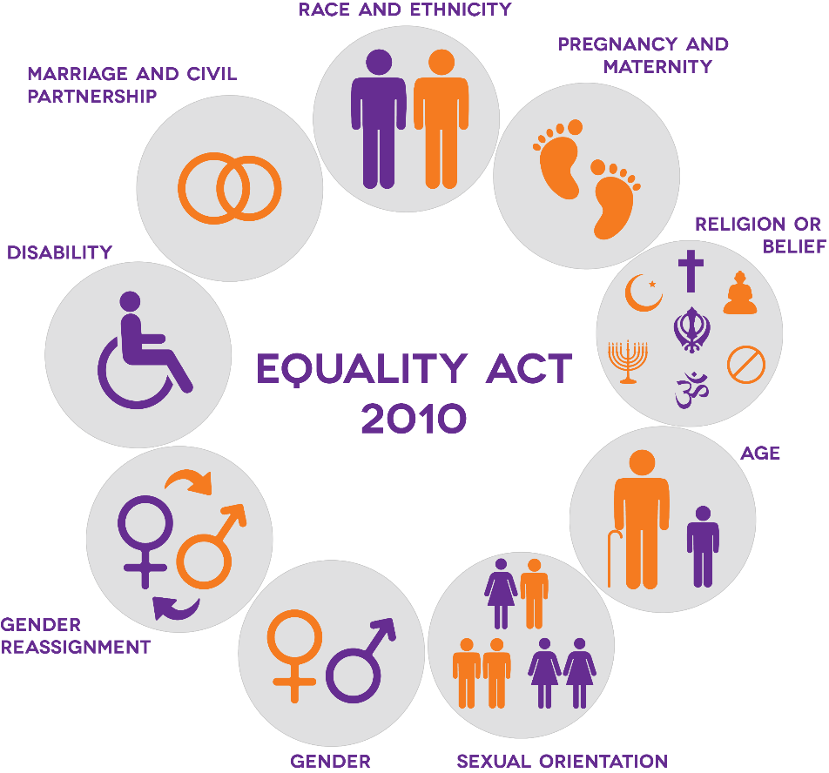
Darfur in Sudan
The Equality Act 2010 – Protected characteristics

Slide 16

Darfur in Sudan
Anti-Muslim hatred
Anti-Muslim hatred is any hateful act aimed at Muslim people, their property or Islamic institutions (e.g. mosques or Islamic schools,) where there is evidence of anti-Muslim motivation or content; or where the victim was targeted because of their Muslim identity. This also includes cases where the victim was perceived to be Muslim.
-Tell MAMA
Case study
Ash Siddique, the secretary of the Al-Madina mosque in Barking, east London, said women coming to the mosque suffered attacks, including one being grabbed around the throat at a bus stop.
‘We’ve had a number of ladies who have been verbally abused and a number of ladies who have been spat on. We’ve had a couple of telephone calls, physical threats – ‘we are going to attack you’ – and that sort of thing.’ said Siddique.
– The Guardian, 7 June 2017
OSCE ODHIR Hate Crime reporting identified 3,469 anti-Muslim hate crimes in the UK in 2021
Allah (God) written in Arabic
Notes:
The OSCE ODHIR Hate Crime data is available at https://hatecrime.osce.org/index.php/united-kingdom.

Slide 17
Questions to answer
Darfur in Sudan
?
How do you think other Muslims who pray at this mosque feel when they hear that some of the other members have faced abuse because of their identity?
Most anti-Muslim attacks happen by men towards women, why do you think this is?
If you witness or experience something like this, what can you do?

Slide 18





Darfur in Sudan
Reporting hate and discrimination
In an emergency call the Police (999)
Report antisemitism to CST – cst.org.uk
Report anti-Muslim hatred to Tell Mama - tellmamauk.org
Report LGBT+ hate crime to Galop - galop.org.uk
Report racism in football to Kick it out - kickitout.org
Report any type of hate crime to True Vision - report-it.org.uk

Slide 19
Plenary
Darfur in Sudan
What is one thing you have learnt during this lesson?
How has this lesson changed your thinking about discrimination?
Is there anything that we discussed that you want to learn more about?
Please write a pledge about how you will address discrimination.

Slide 20

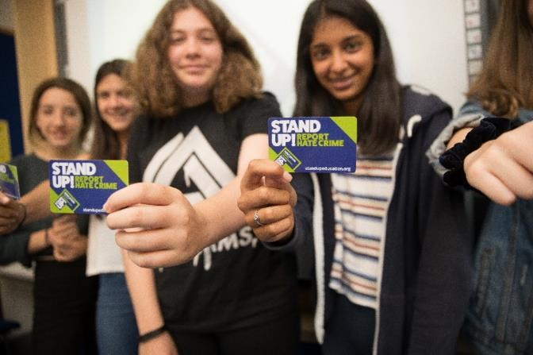
Stand Up! Education Against Discrimination
Darfur in Sudan
Stand Up! is an interfaith project led by Maccabi GB and CST. It brings Muslim and Jewish educators to mainstream school classrooms. Through safe spaces and interactive workshops, students learn to combat racism and discrimination, focusing on antisemitism and anti-Muslim hate. They also learn to report hate crimes and develop a sense of social responsibility to their communities and British society. For more information visit: www.standupeducation.org
Programme supporters:

